Slide 1

App User Manual
Author: Abdullah Bazil, Muhammad Taimoor Sultan, and Maryam Kashif

Slide 2
Table Of Contents
Acknowledgements
About Us
About Our Internship Journey with Clevered
About App
How do I use the App?
Option Names (INSERT PHOTO/VIDEO and DETECT)
Contact Us

Slide 3
Acknowledgements
We would like to express our great appreciation and gratitude to all who have helped us on this journey of App Development. We are thankful for the support that our parents have given us. We strongly appreciate and are grateful for all the support and assistance our mentor has provided us with. Last of all, we express full appreciation and gratitude for the fantastic opportunity to be able to intern under the renowned Mr. Ken.

Slide 4
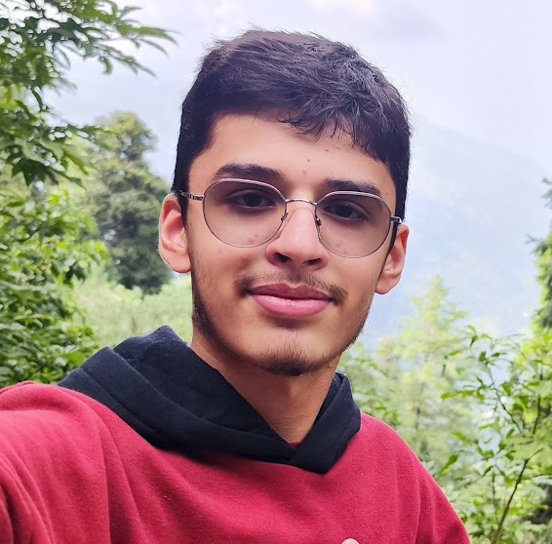
About Us: Abdullah Bazil
My name is Abdullah Bazil, and I was born on September 16th of 2008. I am currently in 10th Grade. I am from Islamabad, Pakistan. I have a number of hobbies and interests, such as computers, and chess. I am interested by our time’s rapidly rising technologies, a notable one being the rise of Artificial Intelligence. I am fascinated by the remarkable potential AI holds for our society, and I am grateful for this amazing opportunity to be able to intern under a renowned professor from Oxford.

Slide 5
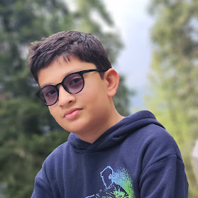
About Us: Muhammad Taimoor Sultan
My name is Muhammad Taimoor Sultan. My age is 12 years old. My previous relationships of AI are from AI foundation to AI Wizard level 2. I am from Islamabad, Pakistan but I currently live in Al Wakra, Qatar. I am in the 7th grade. I enjoy reading books and playing games. I enjoy AI because of the things that I can create.

Slide 6
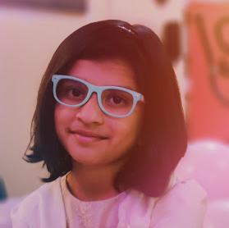
About Us: Maryam Kashif
My name is Maryam Kashif, I am currently in grade 6 and I was born on the 7th of March 2013.I am from Islamabad, Pakistan. I am usually reading or playing games on computer. I am currently doing Ai Wizarding level 1 which in my opinion is much different than the internship classes as the internship classes have more to offer. My interest in Ai is about how the future is shaped through Ai

Slide 7
About Our Internship Journey with Clevered
“Clevered provided us with an amazing opportunity for us to expand our knowledge about the world of coding and programming, as well as AI. We were able to learn Python and utilise Artificial Intelligence with efficiency and ease through Clevered’s well-constructed online sessions, conducted by their more than competent and capable instructors, who taught us about various coding concepts and cleared our doubts, all in an effective manner.” –Abdullah Bazil
“My internship journey with Clevered was great. In the internship I learned about many different libraries and different commands in python. I was able to learn how to make a fire detecting app using python programming. I have learnt more about AI in this internship. ” –Muhammad Taimoor Sultan
“My internship journey with Clevered was in my opinion the best journey with Clevered. I learned new things I didn’t previously even know of. I learned many libraries in python I didn’t even know existed” – Maryam Kashif

Slide 8
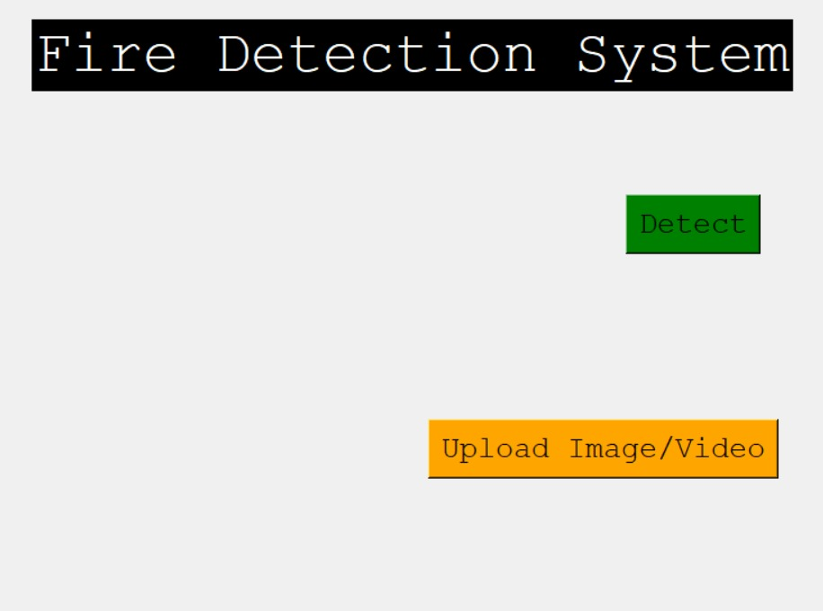
About App
EmberEye is a fire detection system.
It’s goal is to detect fire in a photo or video.

Slide 9
How do I use the App?
You click on the button that says “INSERT PHOTO/VIDEO”.
It then opens up File Explorer, and gives you the option to select a photo or video.
You then click the file you wish to use.
The next step is to click on the button that says “DETECT”.
After doing so, the system will detect whether there is fire or not in the photo or video you gave it.
The system gives the result “FIRE” or “NOT FIRE” at the bottom of the screen.

Slide 10
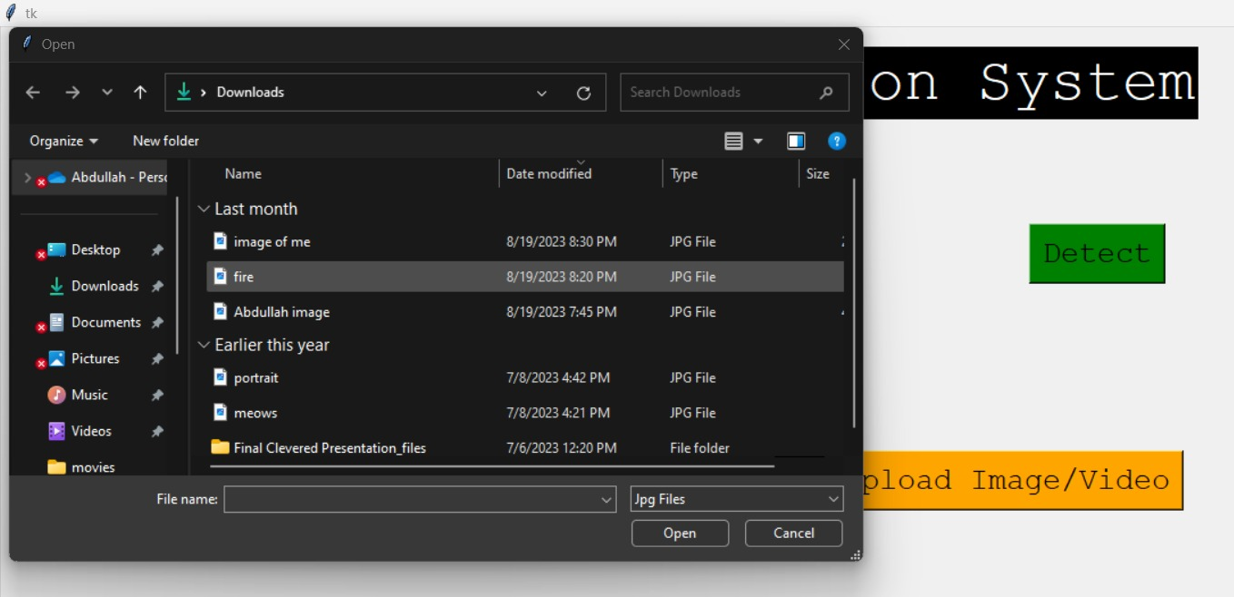
INSERT PHOTO OR VIDEO
After clicking this button, it will open File Explorer and give you the option to choose what photo or video you want to insert. The fire detection system will be used on the selected photo or video.

Slide 11
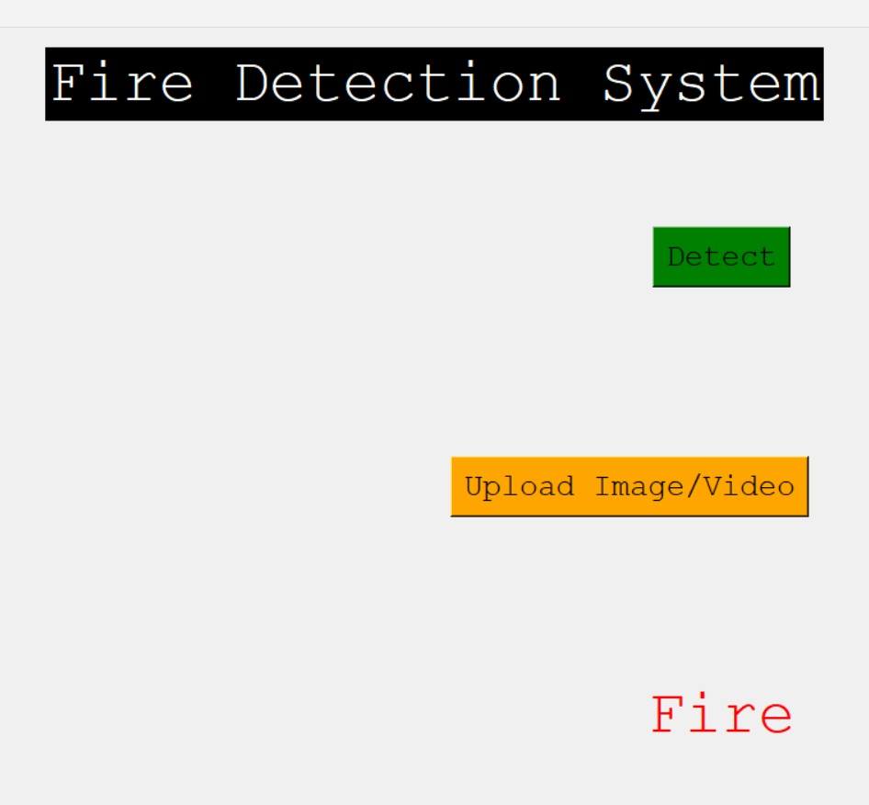
DETECT
By clicking this button, the system will run its fire detection system on the previously selected image or video. The system will give the results at the bottom of the screen.

Slide 12
Contact Us
Please reach out to us at abdbazil08@gmail.com for any questions/concerns/suggestions on the App

Slide 13
Thank You For Your Time!

